Slide 1
Deadlocks
ESHAN COLLEGE OF ENGINEERING, MATHURA

Slide 2
ESHAN COLLEGE OF ENGINEERING, MATHURA
Deadlocks
System Model:
System consists of resources
Resource types R₁, R₂, . . ., R_{m}
CPU cycles, memory space, I/O devices
Each resource type R_{i} has W_{i} instances.
Each process utilizes a resource as follows:
request
use
release
By: Vyom Kulshreshtha
Associate Professor
Computer Science & Engineering

Slide 3
ESHAN COLLEGE OF ENGINEERING, MATHURA
Deadlock Characterization
Deadlock can arise if four conditions hold simultaneously.
Mutual exclusion: only one process at a time can use a resource
Hold and wait: a process holding at least one resource is waiting to acquire additional resources held by other processes
No preemption: a resource can be released only voluntarily by the process holding it, after that process has completed its task
Circular wait: there exists a set {P₀, P₁, …, P_{n}} of waiting processes such that P₀ is waiting for a resource that is held by P₁, P₁ is waiting for a resource that is held by P₂, …, P_{n–1} is waiting for a resource that is held by P_{n}, and P_{n} is waiting for a resource that is held by P₀.
By: Vyom Kulshreshtha
Associate Professor
Computer Science & Engineering

Slide 4
ESHAN COLLEGE OF ENGINEERING, MATHURA
Resource-Allocation Graph
A set of vertices V and a set of edges E.
V is partitioned into two types:
P = {P₁, P₂, …, P_{n}}, the set consisting of all the processes in the system
R = {R₁, R₂, …, R_{m}}, the set consisting of all resource types in the system
request edge – directed edge P_{i} → R_{j}
assignment edge – directed edge R_{j} → P_{i}
By: Vyom Kulshreshtha
Associate Professor
Computer Science & Engineering

Slide 5
ESHAN COLLEGE OF ENGINEERING, MATHURA
Resource-Allocation Graph (Cont.)
Process
Resource Type with 4 instances
P_{i} requests instance of R_{j}
P_{i} is holding an instance of R_{j}
P_{i}
R_{j}
P_{i}
R_{j}
By: Vyom Kulshreshtha
Associate Professor
Computer Science & Engineering

Slide 6
ESHAN COLLEGE OF ENGINEERING, MATHURA
Example of a Resource Allocation Graph
By: Vyom Kulshreshtha
Associate Professor
Computer Science & Engineering

Slide 7
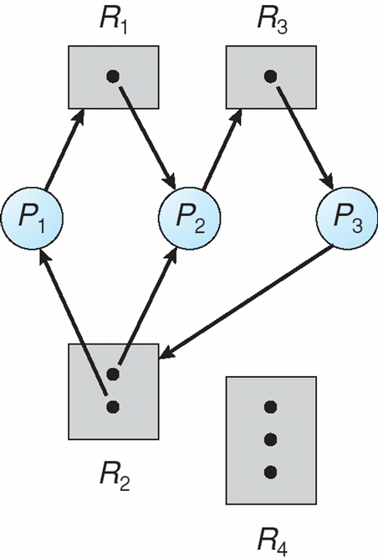
ESHAN COLLEGE OF ENGINEERING, MATHURA
Resource Allocation Graph With A Deadlock
By: Vyom Kulshreshtha
Associate Professor
Computer Science & Engineering

Slide 8
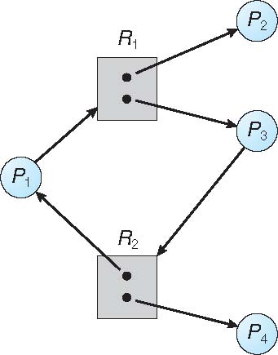
ESHAN COLLEGE OF ENGINEERING, MATHURA
Graph With A Cycle But No Deadlock
By: Vyom Kulshreshtha
Associate Professor
Computer Science & Engineering

Slide 9
ESHAN COLLEGE OF ENGINEERING, MATHURA
Basic Facts
If graph contains no cycles ⇒ no deadlock
If graph contains a cycle ⇒
if only one instance per resource type, then deadlock
if several instances per resource type, possibility of deadlock
By: Vyom Kulshreshtha
Associate Professor
Computer Science & Engineering

Slide 10
ESHAN COLLEGE OF ENGINEERING, MATHURA
Methods for Handling Deadlocks
Ensure that the system will never enter a deadlock state:
Deadlock prevention
Deadlock avoidence
Allow the system to enter a deadlock state and then recover
Ignore the problem and pretend that deadlocks never occur in the system; used by most operating systems, including UNIX
By: Vyom Kulshreshtha
Associate Professor
Computer Science & Engineering

Slide 11
ESHAN COLLEGE OF ENGINEERING, MATHURA
Deadlock Prevention
Restrain the ways request can be made
Mutual Exclusion – not required for sharable resources (e.g., read-only files); must hold for non-sharable resources
Hold and Wait – must guarantee that whenever a process requests a resource, it does not hold any other resources
Require process to request and be allocated all its resources before it begins execution, or allow process to request resources only when the process has none allocated to it.
Low resource utilization; starvation possible
By: Vyom Kulshreshtha
Associate Professor
Computer Science & Engineering

Slide 12
ESHAN COLLEGE OF ENGINEERING, MATHURA
Deadlock Prevention (Cont.)
No Preemption –
If a process that is holding some resources requests another resource that cannot be immediately allocated to it, then all resources currently being held are released
Preempted resources are added to the list of resources for which the process is waiting
Process will be restarted only when it can regain its old resources, as well as the new ones that it is requesting
Circular Wait – impose a total ordering of all resource types, and require that each process requests resources in an increasing order of enumeration
By: Vyom Kulshreshtha
Associate Professor
Computer Science & Engineering

Slide 13
ESHAN COLLEGE OF ENGINEERING, MATHURA
Deadlock Avoidance
Requires that the system has some additional a priori information available.
Simplest and most useful model requires that each process declare the maximum number of resources of each type that it may need
The deadlock-avoidance algorithm dynamically examines the resource-allocation state to ensure that there can never be a circular-wait condition
Resource-allocation state is defined by the number of available and allocated resources, and the maximum demands of the processes
By: Vyom Kulshreshtha
Associate Professor
Computer Science & Engineering

Slide 14
ESHAN COLLEGE OF ENGINEERING, MATHURA
Safe State
When a process requests an available resource, system must decide if immediate allocation leaves the system in a safe state
System is in safe state if there exists a sequence <P₁, P₂, …, P_{n}> of ALL the processes in the systems such that for each P_{i}, the resources that P_{i} can still request can be satisfied by currently available resources + resources held by all the P_{j}, with j < I
That is:
If P_{i} resource needs are not immediately available, then P_{i} can wait until all P_{j} have finished
When P_{j} is finished, P_{i} can obtain needed resources, execute, return allocated resources, and terminate
When P_{i} terminates, P_{i +1} can obtain its needed resources, and so on
By: Vyom Kulshreshtha
Associate Professor
Computer Science & Engineering

Slide 15
ESHAN COLLEGE OF ENGINEERING, MATHURA
Basic Facts
If a system is in safe state ⇒ no deadlocks
If a system is in unsafe state ⇒ possibility of deadlock
Avoidance ⇒ ensure that a system will never enter an unsafe state.
By: Vyom Kulshreshtha
Associate Professor
Computer Science & Engineering

